Slide 1
Description
Differences, along a range of dimensions, offers both challenges and opportunities to any relationship. Learning to identify, reflect upon, learn from, and engage with a variety of perspectives is critical to forming and maintaining an effective mentoring relationship, as well as a vibrant learning environment.
In Advanced Research Mentoring Level 1, you discussed the importance of assessing mentees’ understanding and how to best facilitate their learning. In this session, mentors will expand upon this idea by considering how to foster a successful learning environment where everyone can perform well and create the highest quality of research.
This is the first session in the Advanced Research Mentoring Level 2 series. Attendance at this session is required to earn the VCU Credly Advanced Research Mentoring Level 2 Badge.

Slide 2
Advanced Research Mentoring Level 2
Addressing Equity and Inclusion
Notes:
stacey

Slide 3
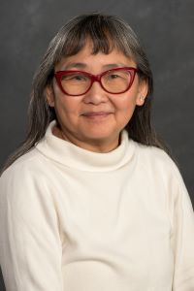
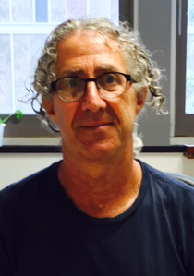
Facilitators
Rita Shiang, PhD
Binks Wattenberg, PhD
Notes:
stacey

Slide 4
Intros
Notes:
stacey

Slide 5

Stories stay but lessons leave
Challenge the idea but not the person
Resist the temptation to multi-task
Try to participate multiple times in every session
Let everybody speak:
  Uninterrupted
  Be mindful of the time you are taking
  Time referees in small groups?
Image by Gerd Altmann from Pixabay
Notes:
Discussions around equity and inclusion can easily exceed the time allotted. If we get to a point where that happens for us, we may skip some of the activities we have planned.

Slide 6
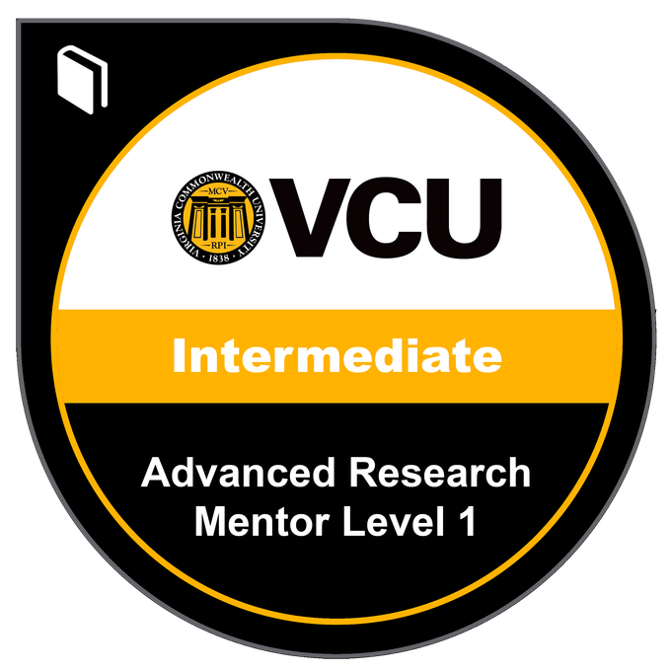

Getting to Know CIMER
Maintaining
Effective
Communication
Aligning
Expectations
Assessing
Understanding
Addressing Meaningful Engagement
Articulating
Your Plan
Promoting Prof. Development
Fostering Independence

Slide 7
Advanced Research Mentoring Level 2
Session | Date | Location
Addressing Meaningful Engagement | 2/10 2:30-4:30 | MMEC 5-101
Assessing Understanding and Fostering Independence part a | 3/10 2:30-4:30 | MMEC 5-101
Fostering Independence part b and promoting professional development | 4/7 2:30-4:30 | MMEC 3-101
Articulating Your Mentoring Philosophy and Plan | 5/12 2:30-4:30 | MMEC 3-101

Slide 8
Learning Objectives
Mentors will have the knowledge and skills to:
1. Expand understanding of equity and inclusion and how diversity influences mentor-mentee interactions
2. Recognize the potential impact of conscious and unconscious assumptions, preconceptions, biases, and prejudices on the mentor-mentee relationship and reflect on how to manage them
3. Identify concrete strategies for learning about, recognizing, and addressing issues of equity and inclusion in order to engage in conversations about diversity with mentees and foster a sense of belonging

Slide 9
Objective 1

Slide 10
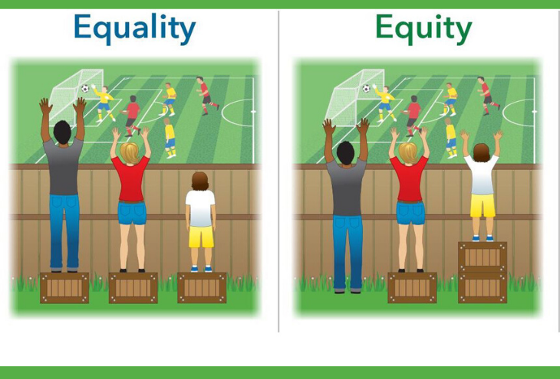

Equity & Inclusion
Notes:
Equity is about giving everyone what they individually need to be able to participate/see what is happening/do research (ex. Having a lab bench at the height someone would need if they used a wheelchair)
Inclusion- making sure everyone feels welcome to be in the space and valued for their contribution to it

Slide 11



What makes you… you?
Notes:
Everyone sees the world through their own cultural lens- our diversity comes from our biography, from our own lived experiences.
On a piece of paper, I invite you to list three things about yourself that are not directly related to your work or career. I’ll give you three minutes to do this and then you can pair up and share what you wrote. Please know- you can share as much or as little as you are comfortable with.
talk in pairs for 5 minutes,
ask folks to share things that they learned about their partner and take notes on a flip chart (5 minutes)

Slide 12
Objective 2
Notes:
In this society, it is engrained in our subconscious to first think of diversity in terms of race and ethnicity, but remember that it is broader than that. For example, consider the impact of learning and physical disabilities, gender, age/generation, sexual orientation, class, religion, and differences in communication, learning, and work styles. Think about the list we generated just now. Do you have any characteristics you would like to add to the list?

Slide 13

What are some ways that mentors can differ from their mentees?
Notes:
What do you some ways that mentees can differ from their mentors? How do these differences influence mentoring relationships and how can they be capitalized on to innovate/

Slide 14
How do differences influence mentor-mentee interactions?
How can differences
  be capitalized on to stimulate high quality research?
  pose challenges to effective mentoring?
How can you encourage research team members to have an appreciation for differences?

Slide 15
Take a moment
Focus on the first image that comes to mind and quickly write down 3 words to describe the picture in your head.
Notes:
Cook
2. Pilot
3. Mountain Climber
4. Caretaker
5. Politician
6. Researcher
7. Graduate Student
8. Postdoc
9. PI

Slide 16
What does the data say?
Read your case study.
Discuss your selected case with a partner.
Discuss your case and overall thoughts and reflections related to addressing equity and inclusion in biomedical research.

Slide 17
Diversity Research
Notes:
Let’s take the next 8 minutes to read about some results of studies about diversity in research. Look at each and make notes on how they could impact your mentoring practice. Choose one in particular that you would like to discuss with a partner.

Slide 18
Debrief
1. What were your initial reactions?
2. Which study captured your attention? Why?
3. What implications do these results have for your mentoring practice?
4. What are 2-3 practical things you could do to minimize the impact of bias, prejudice, and stereotype in your mentoring relationship?
ACTIVITY #

Slide 19
Debrief
Notes:
What do you think about mentoring compacts?
How could you use them in your lab?
*Highlight the importance of communicating and fostering shared understanding of the compacts as the end goal- not merely creation.
How often is it necessary to revisit a mentoring compact?
Where should it live?

Slide 20
Case Studies
Review the Case Study (8 minutes)
Group Discussion

Slide 21
ADDRESSING EQUITY AND INCLUSION-CONCLUSIONS
We all carry unconscious assumptions.
Being conscious of them could minimize their effect on our behavior.
What strategies for addressing equity and inclusion have become more apparent to you today?
How you change your compact with regard to DEI based on what you learned today?

Slide 22
Reflection
How do you promote an inclusive research environment?
What implicit biases do you have?
Browse and select a few Implicit Association Tests to try and record your results

Slide 23

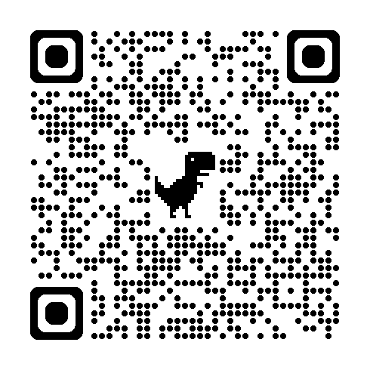
Evaluation
Evaluation Link

Slide 24
Resources for additional learning
CIMER
  VCU facilitators and programs
NIH OITE (https://www.training.nih.gov/)
  Sharpening your Mentoring Skills
Project Implicit: https://www.projectimplicit.net/

Slide 25
Thanks!
Any questions?
Stacey Wahl, PhD
stacey.wahl@vcuhealth.org

